Slide 1
Home Insurance

Slide 2
Agenda
Background
The Target Areas for Improvement
Approaches
Results
Next Steps
Future Working Arrangement
Questions

Slide 3
Background
Worked in an RnD team of two people and was only data analyst
My company only built the software, needed client buy-in to use their anonymised production data to build our ideas
This was the first project that was undertaken with the client and helped gain their buy-in to the arrangement

Slide 4
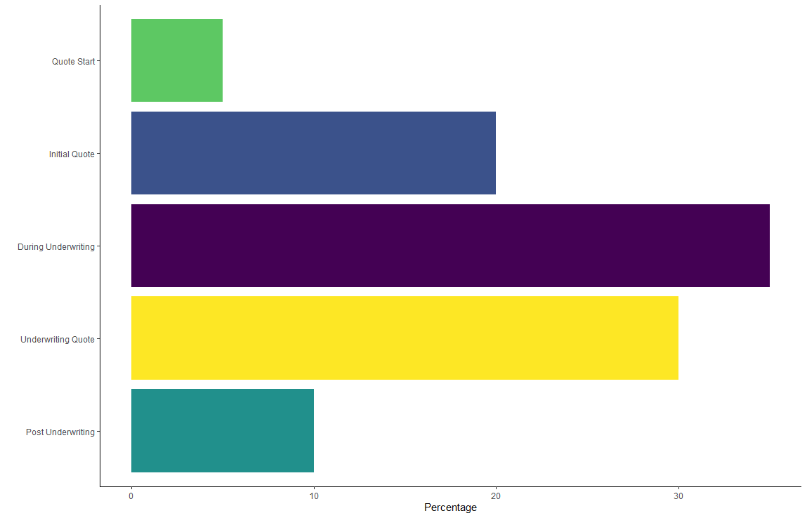
Underwriting Question Drop-off

Slide 5
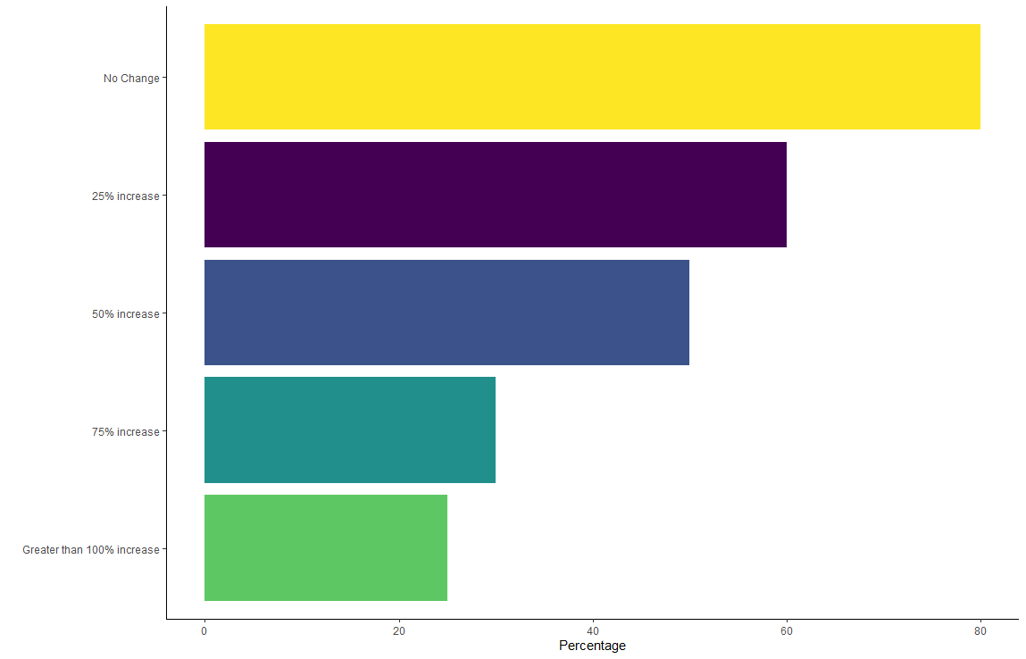
Underwriting Quote Drop-off

Slide 6
The Targets
B2B and D2C: Find and update confusing underwriting questions; delete any unnecessary questions
D2C: Update the user journey to achieve a more accurate quote at the initial quote stage
B2B: Decrease time for agents to get an accurate quote

Slide 7
Underwriting Question Analysis
6 Questions account for 80% of the ratings
7 Questions were redundant
4 Questions had significantly high drop-off rates and could be re-worded

Slide 8
Underwriting Question Changes
Migrated key questions from underwriting section to initial quote section
Removed redundant questions and re-ordered dominant allele questions
Re-phrased questions to increase understanding and added information boxes

Slide 9
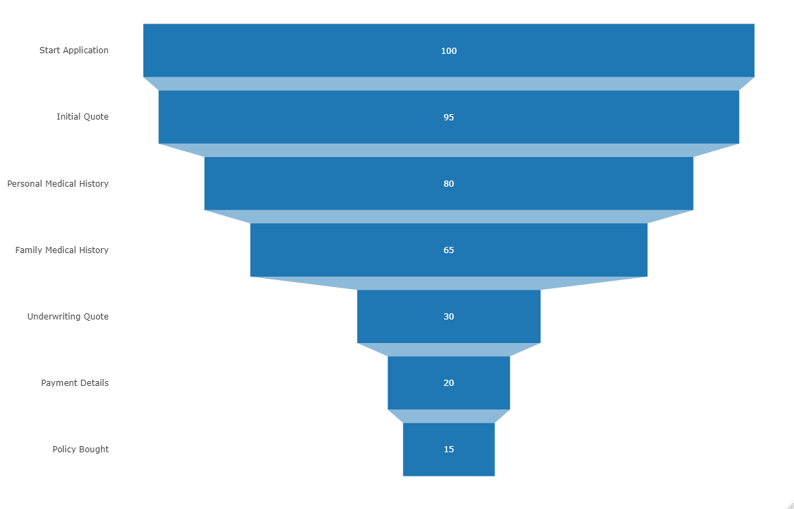
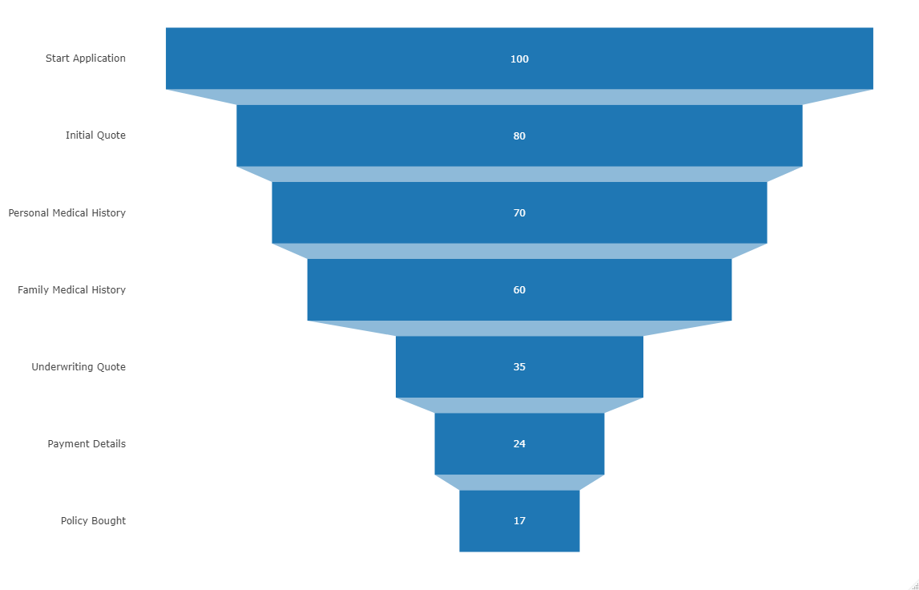
Underwriting Changes - Results
Before
After

Slide 10
Quick Quote Functionality
Agents currently spend an average time of 22 minutes before they provide a client with an accurate quote
24% of applications result in policies
2750 Policies/Month

Slide 11
Quick Quote Functionality - Results
Average time reduced to under 5 minutes for a quick quote
65% of applications that had a full underwriting ended up as policies
3,300 policies per month and over 10,000 quick quotes

Slide 12
Next Steps
Monitor underwriting question drop-offs to detect if further changes are needed
Time investment focussed on optimal ways of asking questions between personal and family medical history
Track quick quote usage and gather feedback from agents

Slide 13
Future working arrangement
This concept was then sold at full price to our other clients
The success of this project built the platform that allowed us to build our insurance reporting suite using their data
The insurance reporting suite was sold at full price to other clients

Slide 14
Questions?

